Slide 1
Serverless Computing – Reducing Infrastructure Management in the Cloud
Presented By
Name: Ch. Tharunika Reddy
Course: Cloud Computing and Big Data Analytics
Course Code: CSA15
Regno:192324307
Notes:
Introduce yourself and the topic. Replace the [Name] and [Register Number] placeholders before presenting.

Slide 2
What is serverless computing?
Introduction
Objective
Serverless computing is a cloud computing model where developers can run applications without managing servers.
The cloud provider manages the servers, infrastructure, scaling, and maintenance.
Developers can focus mainly on writing and deploying application code.
To understand the concept of serverless computing.
To learn how serverless architecture works.
To understand its advantages and industry applications.
To study a practical example using AWS Lambda.
Notes:
Define serverless in one sentence, then state the three objectives of the presentation.

Slide 3
How serverless computing works
1
User sends a request
2
Request reaches the cloud platform
3
A serverless function is triggered
An action such as opening an app or calling an API.
The platform receives it via an API gateway or trigger.
The function starts on demand, only when needed.
4
Function processes the request
5
Result is returned to the user
6
Resources are automatically scaled based on demand
The output goes back and the function stops.
Your code runs and may read or write data.
More copies run when traffic rises, fewer when it falls.
Key concept:
Write Code → Deploy Function → Cloud Manages Infrastructure
Notes:
Walk through the six steps in order, using the short explanation under each one. Close with the key concept: you write and deploy code, the cloud handles everything underneath.

Slide 4

Serverless architecture
User
API Gateway
Receives requests.
API Gateway
Function
Executes application logic.
Database
Serverless Function
Stores application data.
AWS Lambda
Cloud Storage
Stores files and objects.
Database
Cloud Storage
Notes:
Follow a request from the user down through the API Gateway to the Lambda function, which reads or writes the database and cloud storage. Then go through the four components on the right.

Slide 5
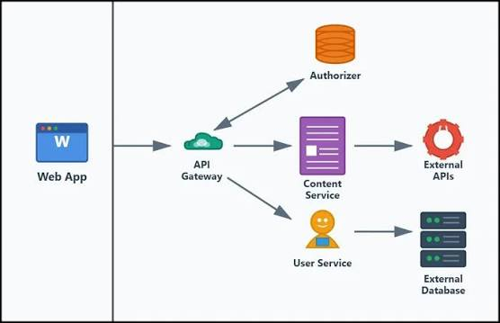
Advantages of serverless computing
No server management
Automatic scaling
Pay-as-you-use pricing
Faster development
High availability
Reduced infrastructure cost
Developers can focus on application development.
Notes:
Cover each advantage briefly. Stress pay-as-you-use: you are charged only while the function runs.

Slide 6
Industry Relevance
Web Applications: Used to build scalable web and mobile backends.
E-commerce: Handles sudden increases in customer requests during sales.
Data Processing: Processes large amounts of data automatically.
IoT: Responds to data and events generated by connected devices.
Media Processing: Automatically processes uploaded images, videos, and files.
Financial Services: Supports event-driven transactions and automated workflows.
Business Benefit: Reduces server management and allows organizations to scale applications based on demand.
Notes:
List the main use cases, then explain why industry adopts serverless: faster delivery with no servers to maintain.

Slide 7

Practical example: AWS Lambda
User uploads image
Image Processing
Processed Image
Cloud Storage
AWS Lambda
Example
Technologies
When a user uploads an image, the upload event triggers an AWS Lambda function. The function can automatically resize or process the image and store the result.
Amazon S3
AWS Lambda
API Gateway
Notes:
Use the image-upload scenario to make the idea concrete: the upload is the event, Lambda is triggered automatically, and the processed image is stored back.

Slide 8
Conclusion
Serverless computing eliminates the need for developers to manage servers.
It provides automatic scaling and efficient resource usage.
It supports faster application development.
It is useful for event-driven and cloud-based applications.
Key takeaway
Serverless does not mean there are no servers; it means the cloud provider manages the servers for you.
Notes:
Recap the four conclusions, then end on the key takeaway. Thank the audience and invite questions.

Slide 9
Thank You

